Slide 1
Diagnosis of acute diseases in villages and smaller towns using AI
PIP2001 Capstone Project
Final Review
Batch Number:CEI-G23
Under the Supervision of,
Dr. Pajany M.
Professor / Associate Professor / Assistant Professor
School of Computer Science & Engineering
Presidency University
Roll Number | Student Name
20211CEI0063 | Pushpam Agrawal (Leader)
20211CEI0064 | Abdul Rahman Mansoori
20211CEI0087 | Sawood Ahmed
20211CEI0085 | Chethan S. G.
20211CEI0076 | Abhijeeth V.
Name of the Program: Computer Engineering (Artificial Intelligence & Machine Learning)
Name of the HoD: Gopal Krishnan
Name of the Program Project Coordinator: Dr.Pallavi
Name of the School Project Coordinators: Dr. Sampath A K / Dr. Abdul Khadar A / Mr. Md Ziaur Rahman

Slide 2
Content
Problem Statement
GitHub Link
Analysis of Problem Statement
Timeline of the Project
References

Slide 3
Problem Statement Number: PSCS46
Organization: Max Healthcare
Category (Hardware / Software / Both): Software
Problem Description: Supply of doctors is limited in India especially in smaller towns and villages making provision of healthcare difficult to a large number of people. Telemedicine and other solutions in the past have also struggled to scale up due to this problem. Now in the age of digital assistants like Google and Alexa, can we create artificial intelligence based "doctor" that can diagnose everyday acute diseases like common cold, flu, etc, based on simple questions?
Difficulty Level: Complicated

Slide 4
GitHub Link
The GitHub link provided should have public access permission.
GitHub Link:-
https://github.com/Pushpam-1412/Diagnosis-of-Acute-Disease

Slide 5
Analysis of Problem Statement
Key Challenges:
a) Shortage of Doctors:
Rural and semi-urban areas often lack sufficient medical professionals, resulting in delayed treatments or unavailability of timely healthcare.
Existing telemedicine solutions still require doctors on the other end, which limits scalability when a large population requires access to healthcare.
b) Telemedicine Limitations:
While telemedicine reduces physical barriers, it still relies heavily on human doctors, thus suffering from the same bottleneck of limited availability.
The effectiveness of telemedicine platforms depends on good internet connectivity, which may not always be available in remote areas.
c) Lack of Scalability:
Existing healthcare models and telemedicine platforms have struggled to scale because they are resource-intensive and not fully automated. Scaling up requires either more human resources or advanced AI-driven

Slide 6
Analysis of Problem Statement (contd...)
Feasibility and Components of AI-based Diagnosis System:
a) Data-Driven Diagnosis:
Training AI models on large medical datasets can allow the system to learn from symptoms and make informed guesses about possible diagnoses. AI models like decision trees, random forests, or deep learning techniques can be trained on symptoms and patient histories to predict likely conditions.
Bayesian networks or probabilistic models can help in decision-making based on symptoms, enabling the AI to make reasonable guesses even when complete data is unavailable.
b) NLP for Interaction:
Using Natural Language Processing (NLP), the AI can ask patients questions about their symptoms (such as "Do you have a fever?" or "How long have you had a sore throat?"). Based on their responses, the AI can analyze their conditions.
NLP models like BERT or GPT-4 can help the AI understand patient responses and engage in conversations to gather relevant information.

Slide 7
Analysis of Problem Statement (contd...)
Software and Hardware Requirements:
Software Requirements:
Operating System: Windows 10 or greater
Python: Version 3.12.4
Libraries:
Numpy
Pandas
Generative AI Models

Slide 8
Analysis of Problem Statement (contd...)
Hardware Requirements:
CPU/GPU:
CPU: i5 10th gen or greater
GPU : GTX1650ti or greater
Memory: 16GB RAM for small-scale development.
Storage: 512 GB or more

Slide 9
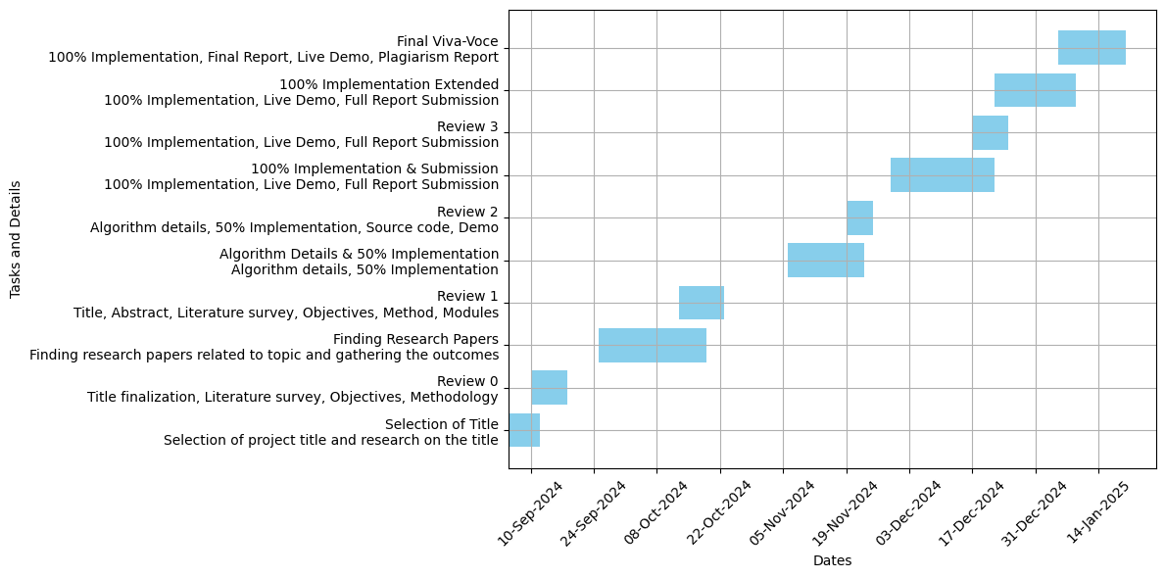
Timeline of the Project (Gantt Chart)

Slide 10
References (IEEE Paper format)
https://www.ijcrt.org/papers/IJCRT2401112.pdf
https://ijrpr.com/uploads/V5ISSUE1/IJRPR21816.pdf
https://www.indeed.com/career-advice/career-development/how-to-cite-a-research-paper
https://ijrpr.com/uploads/V6ISSUE1/IJRPR37854.pdf (Our Teams Research Paper)

Slide 11


